Slide 1
Introducing
Mouse Model Archive

Slide 2
What is Mouse Model Archive (MMA)?
A web-based platform for
design and analysis,
management, recording, and sharing
of mouse model creation data

Slide 3
Present Systems
General Information
Genomic Sequences
Targeting Vector
Publications
Design Schematics
Discussions
Screening/ genotyping strategies
Phenotypes
Experimental
Results

Slide 4
Present Systems
Ensembl
NCBI
General Information
Genomic Sequences
Repeat Masker
Pubmed
Targeting Vector
Publications
Scattered, disorganized, stand alone data sets
BLAST
Design Schematics
Emails
Discussions
Phone calls
Webcutter
Screening/ genotyping strategies
Mouse Phenome DB
Gel photos
Phenotypes
MGI
Experimental
Results
Figures/tables
GenSAT
Lab notebooks

Slide 5
Mouse Model Archive
Documentation
General Information
Genomic Sequences
Collaboration
Targeting Vector
Publications
Centralized, integrated, organized, collaborative
Design Schematics
Discussions
Sharing
Screening/ genotyping strategies
Phenotypes
Monitoring
Experimental
Results

Slide 6
Mouse Model Archive Highlights

Slide 7
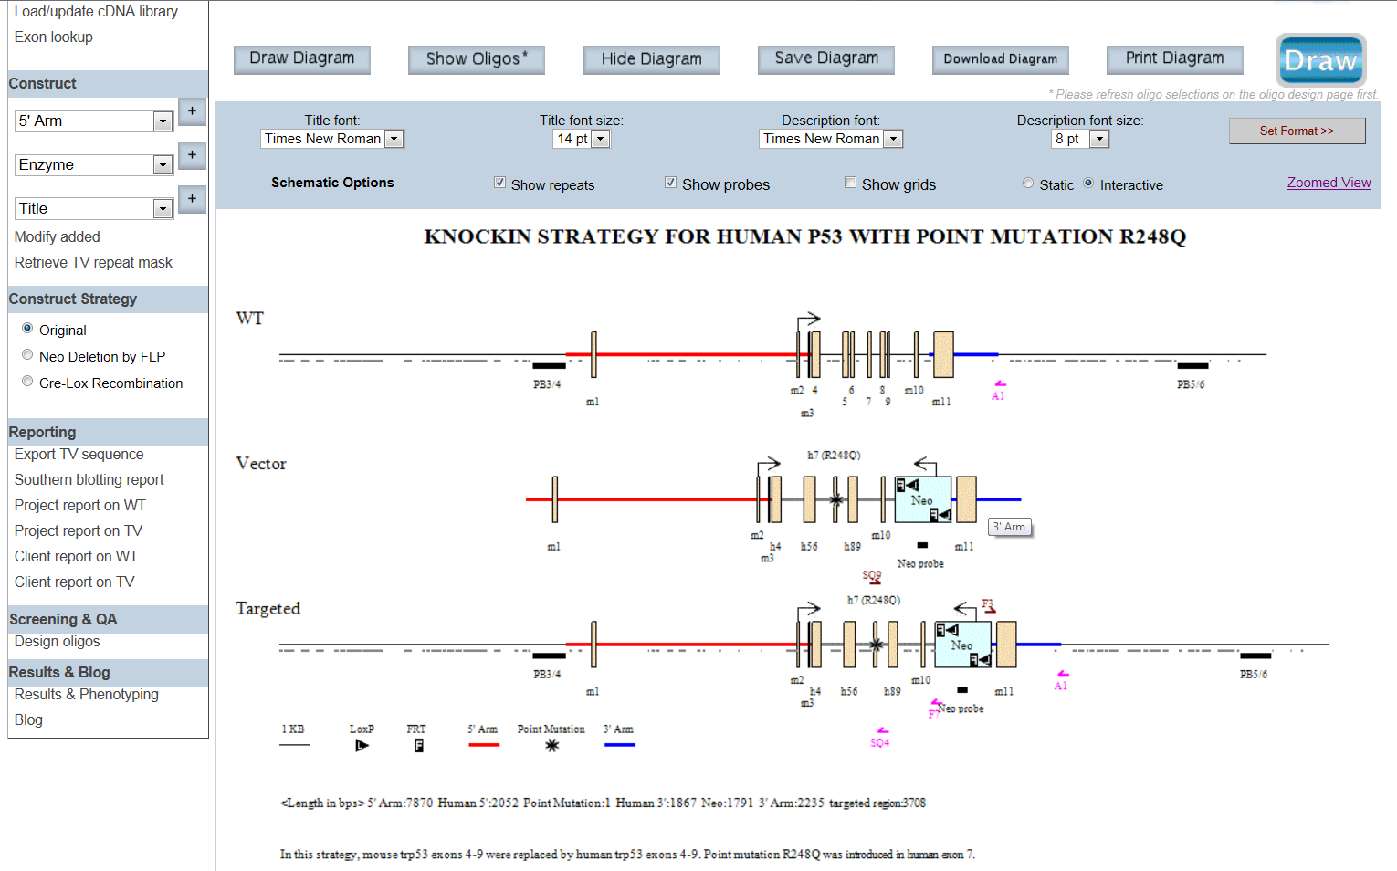
Display Options
Customize font style/size
Title
Schematic Diagram
Description

Slide 8
Display Options
Sizes of vector components
Vector Details

Slide 9
Display Options
Regions of repeats

Slide 10
Display Options
Location of primers/probes

Slide 11
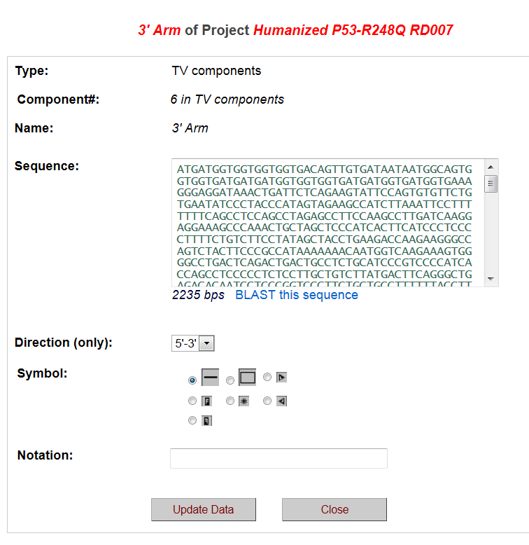
Display Options
Interactive mode

Slide 12
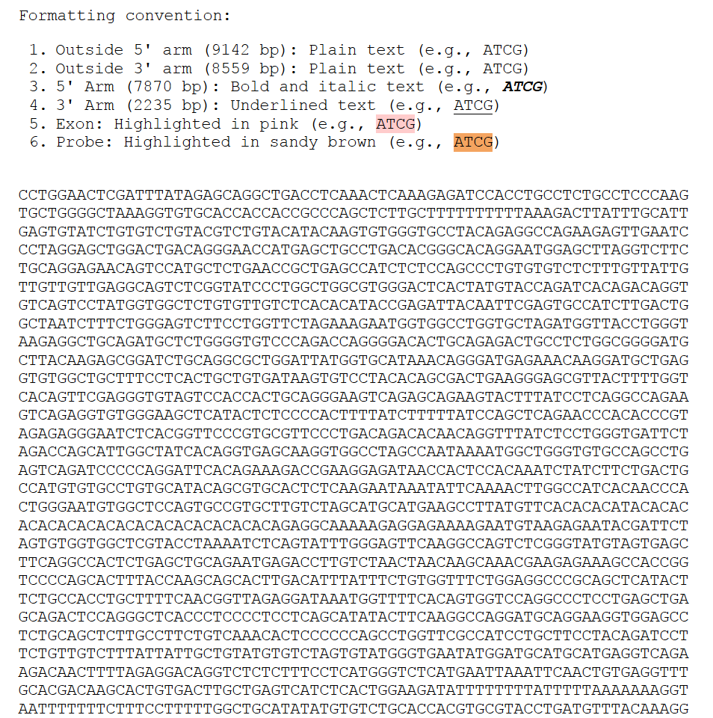
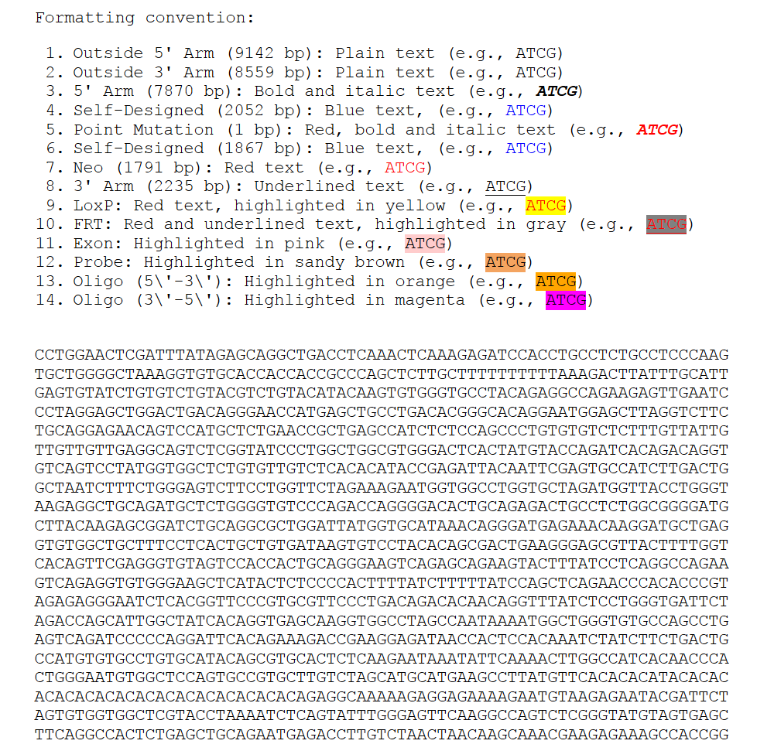
Generated Reports
Annotated sequences of WT and KO/KI alleles

Slide 13
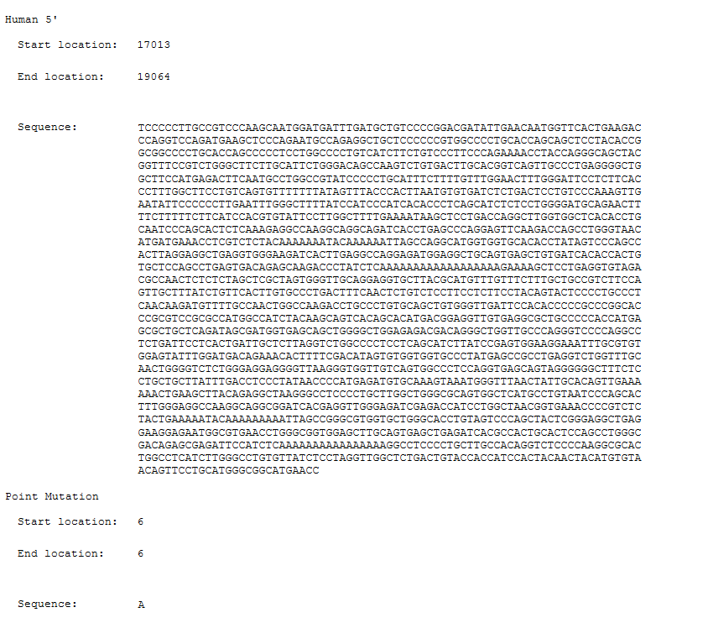
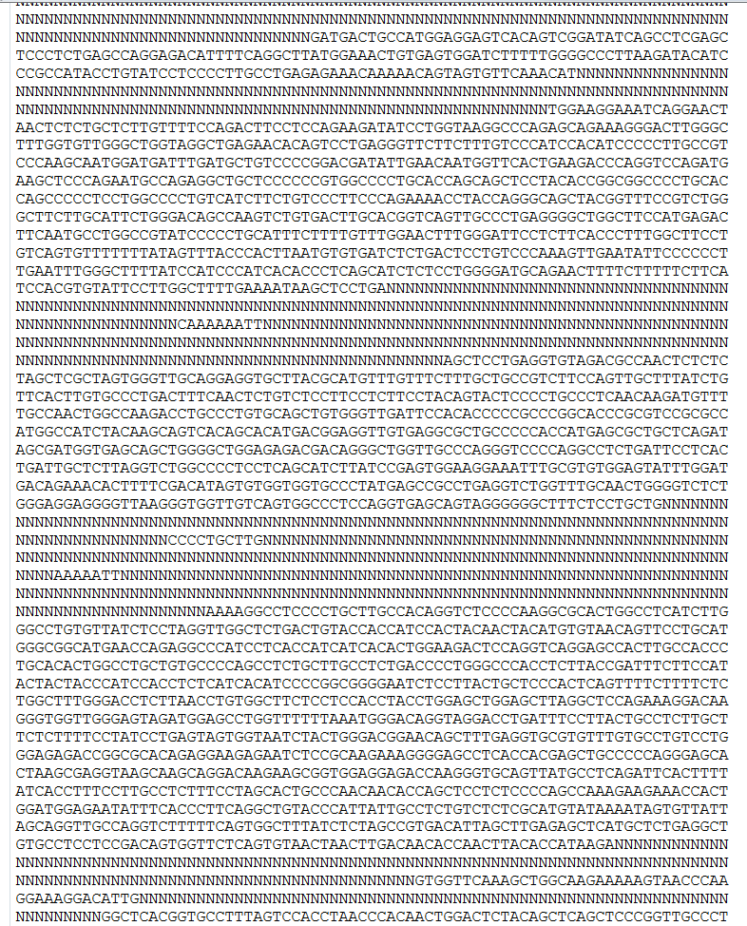
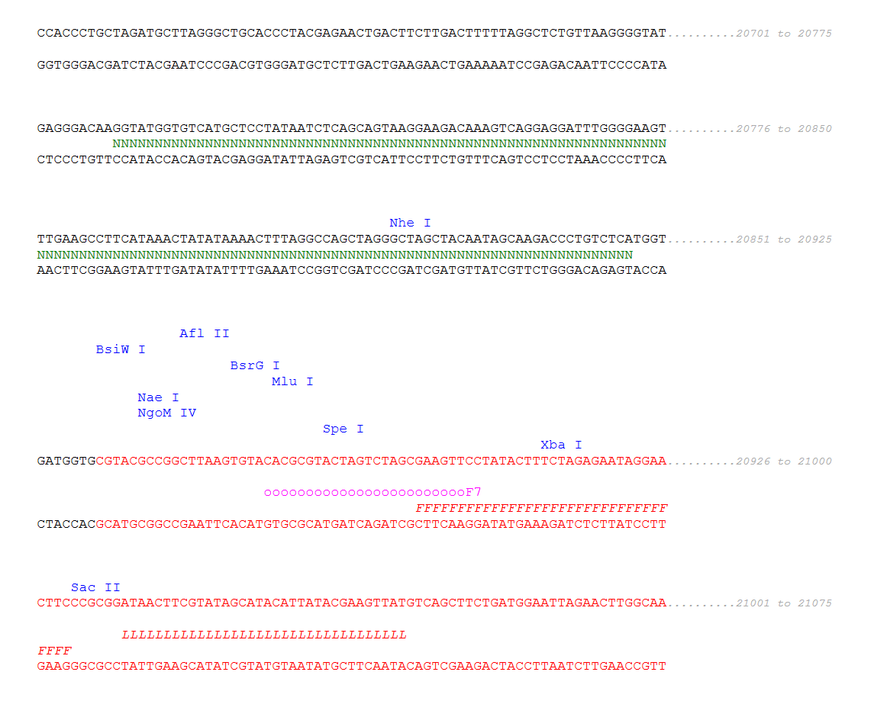
Generated Reports
Repeat Mask report indicates repeat regions.
Project report annotates insertion sites, primer/probe location, enzyme sites, repeats, etc.
Vector sequence report shows component sequences, start/end location, sizes, etc.

Slide 14
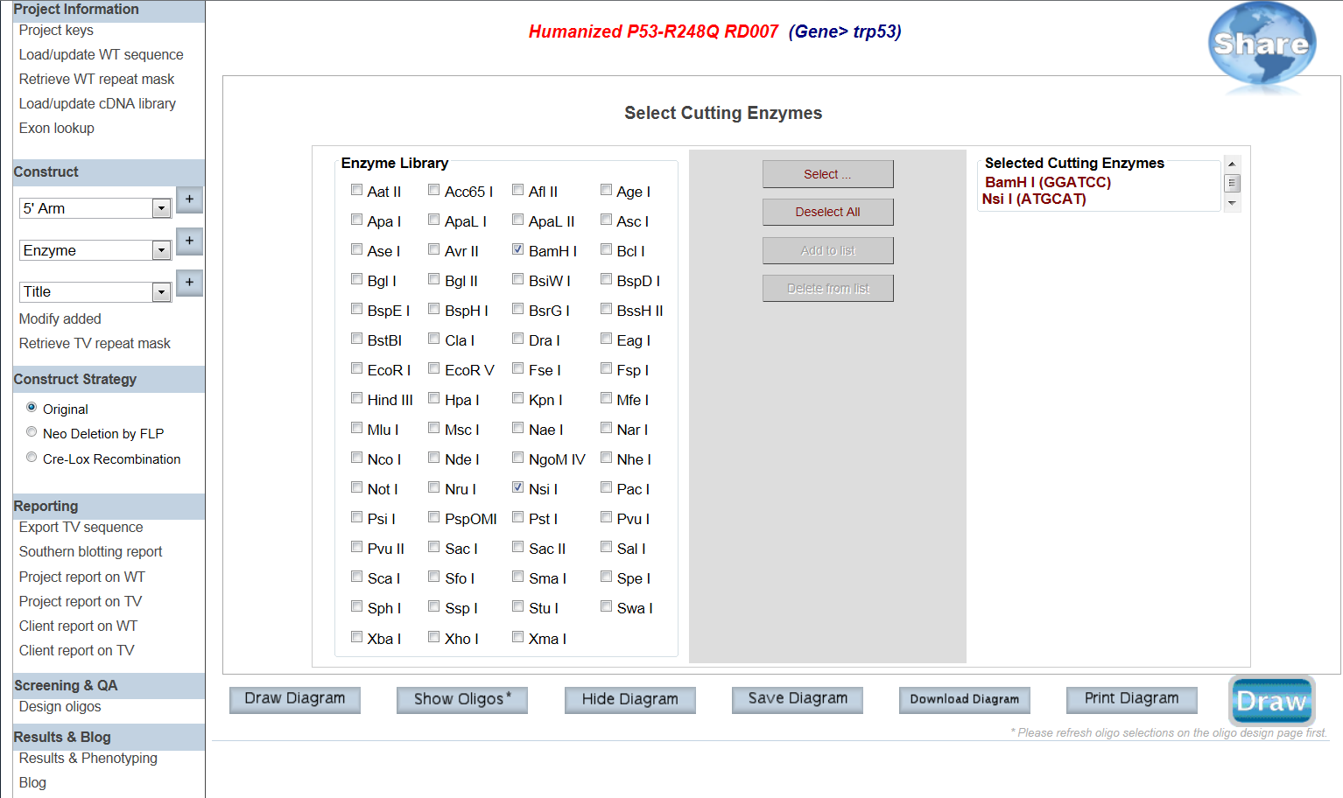
Select enzymes to display all possible cutting sites
A list of over 50 enzymes to select from
Selected enzymes display on schematic diagram

Slide 15
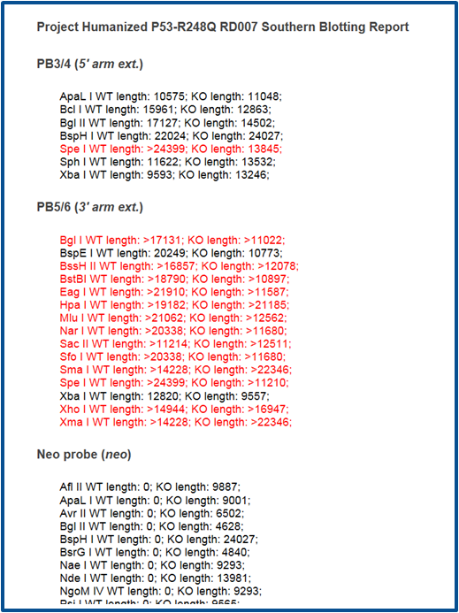
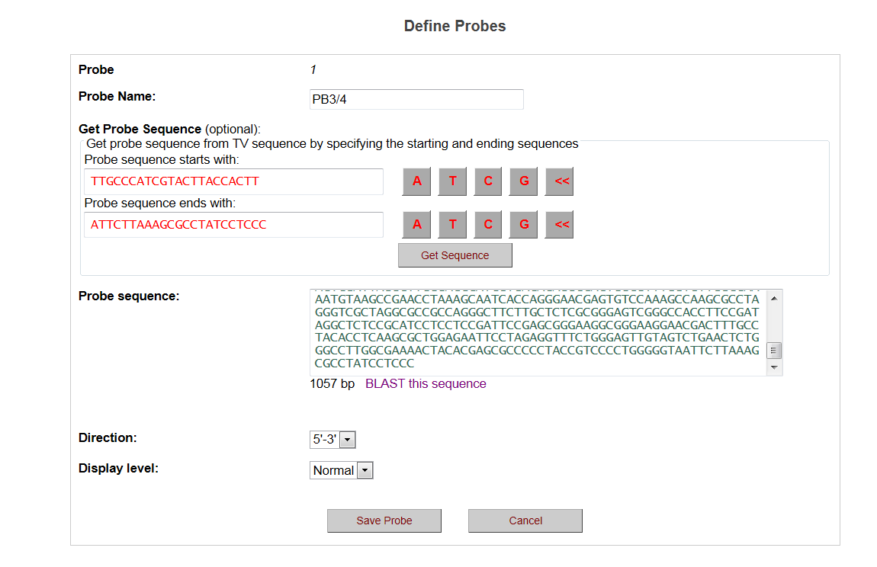
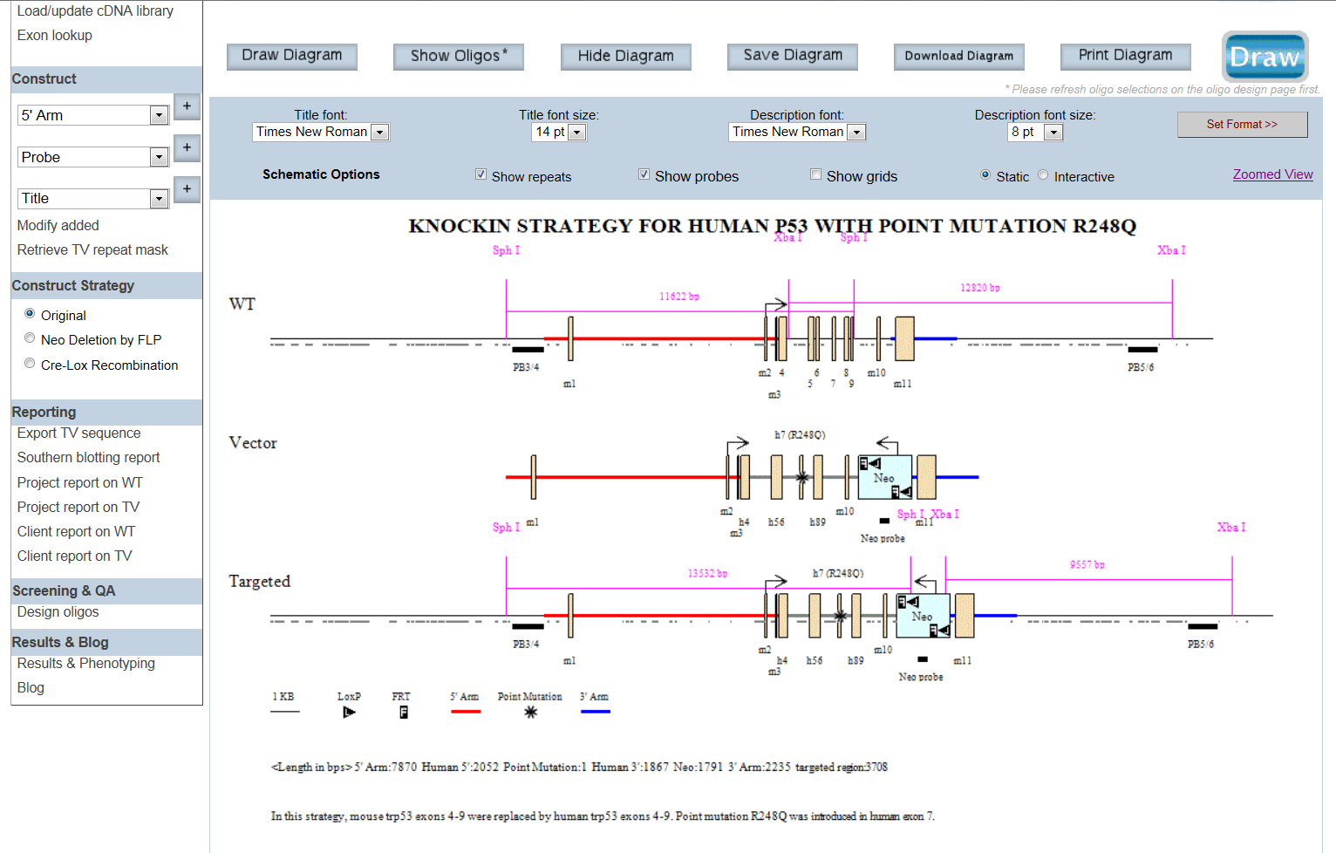
Design Southern strategy
Design your probe
Southern Report generated for your probes
Select enzymes to display for your probes
Display your selected enzymes with probes on schematic diagram

Slide 16
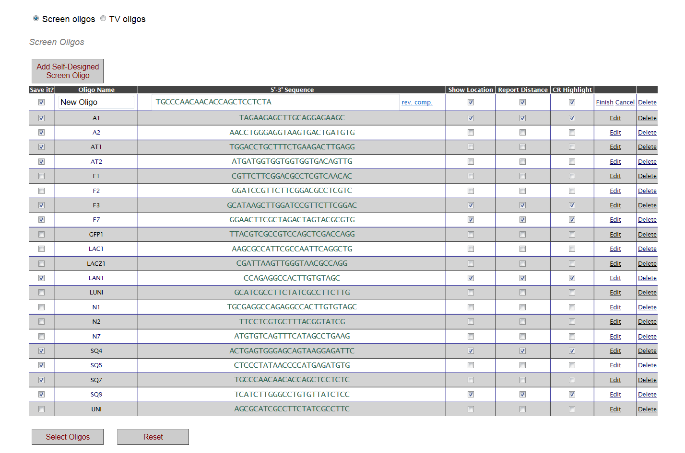
Design PCR primers
Design your primer
Show location & direction of primer
Wrong sequence entered
Display primers on schematic diagram
Show expected sizes of primer pairs

Slide 17
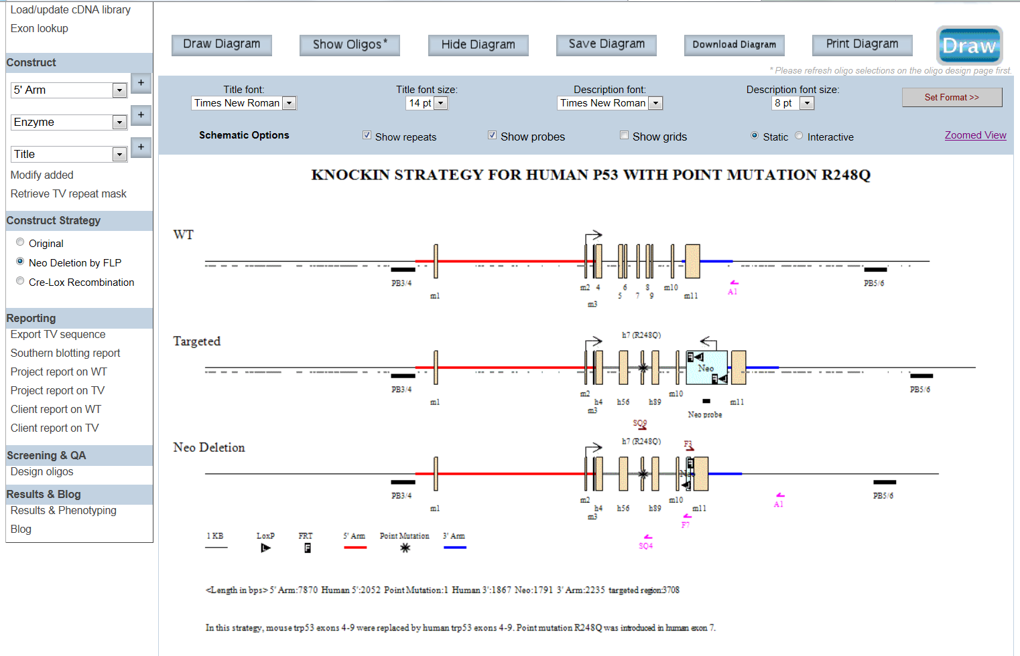
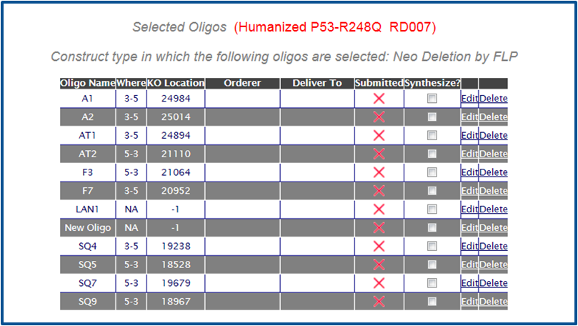
Display mating schemes (FLP/Cre)
Display changes to primer location and pairing sizes
Neo deleted
Display new schematic diagram
Neo primer no longer presents

Slide 18
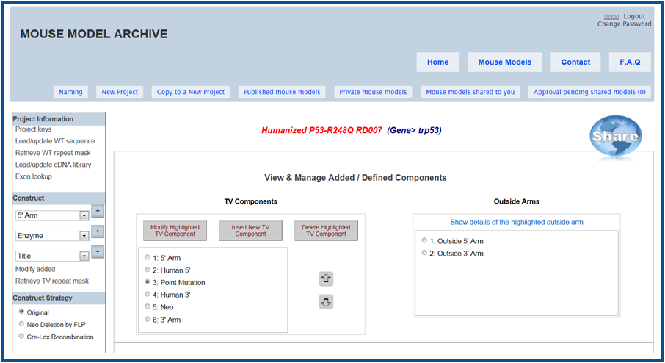
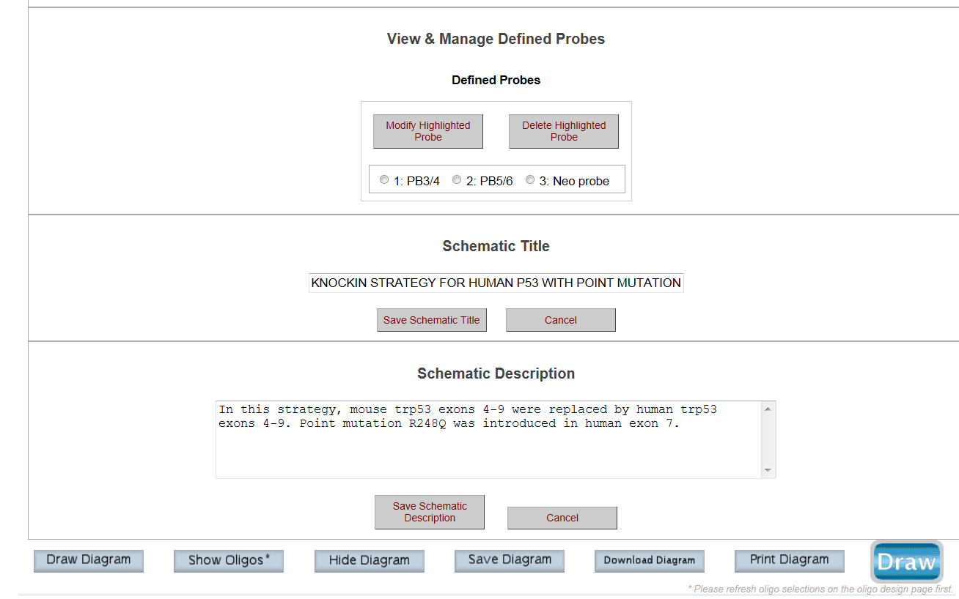
Modify any components
Make changes to vector components, probes, title, description, etc.

Slide 19
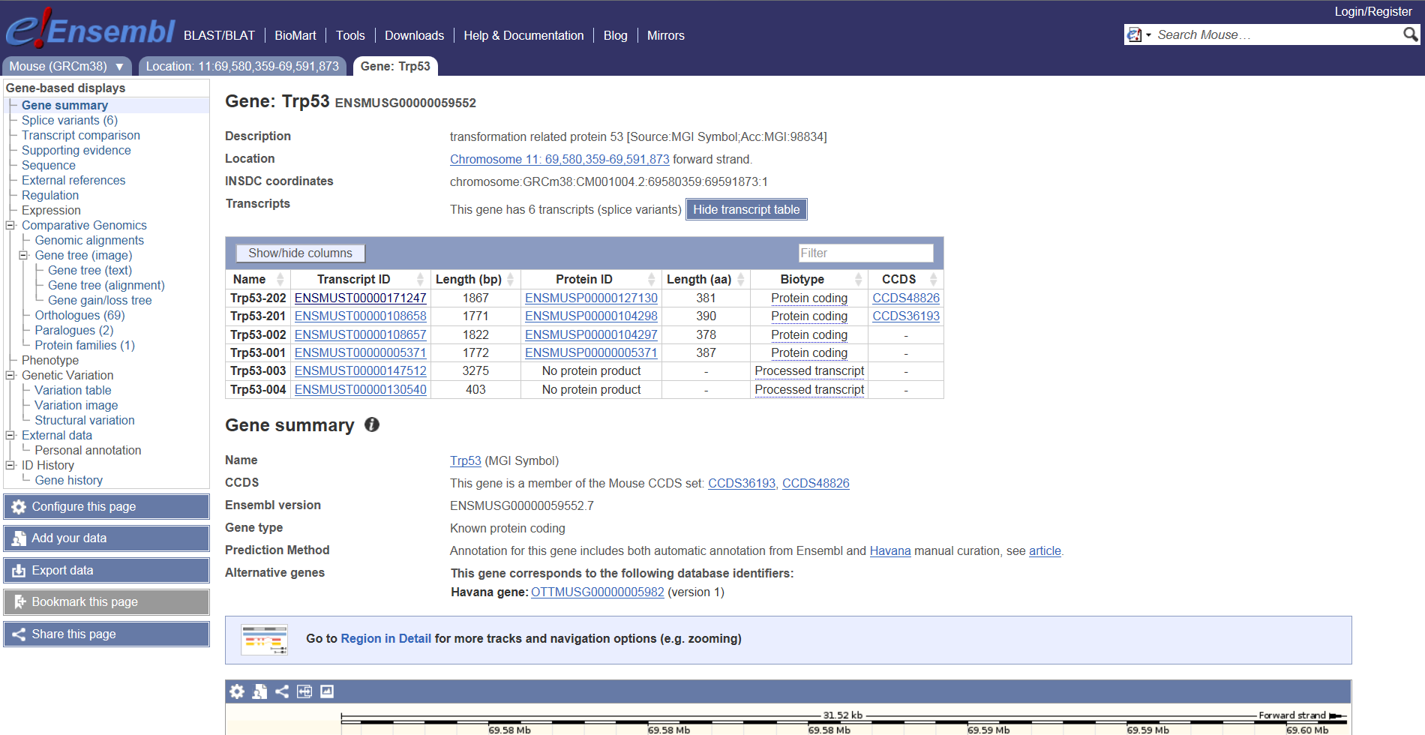
Direct Linkouts to Other Sites
Linkout to Ensembl for your gene

Slide 20
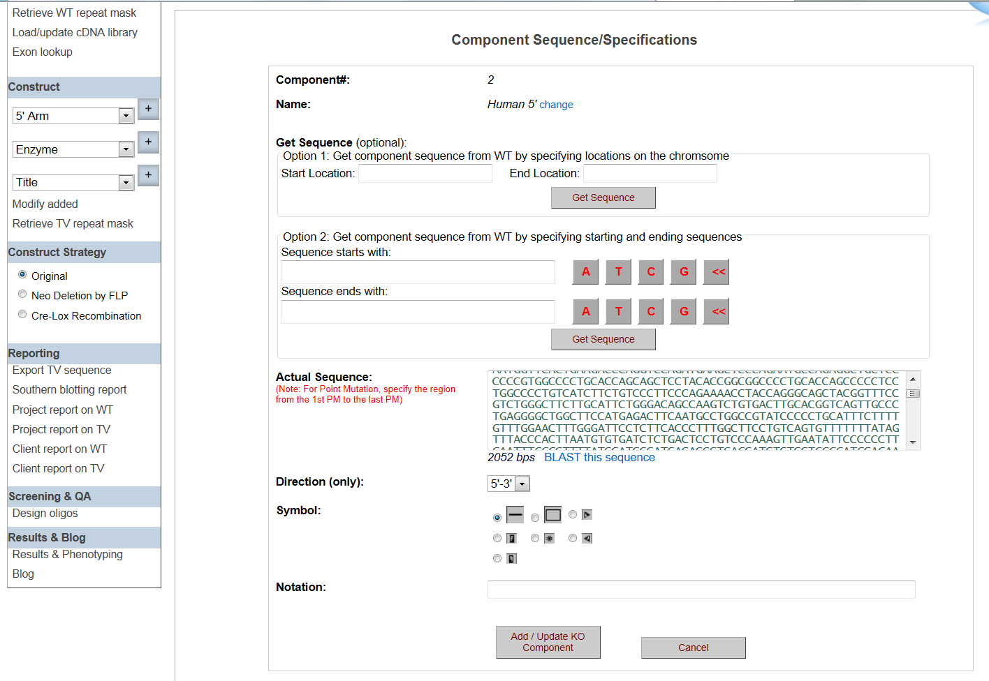
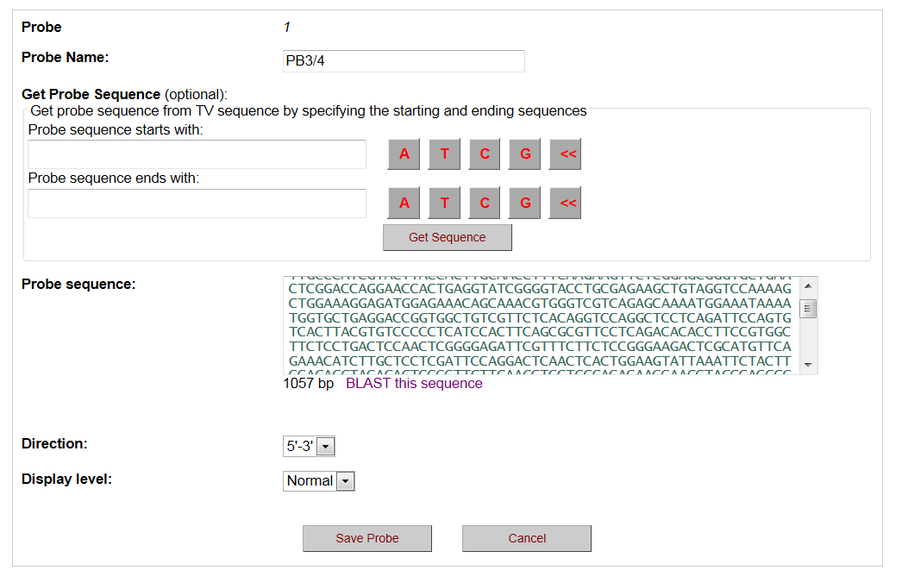
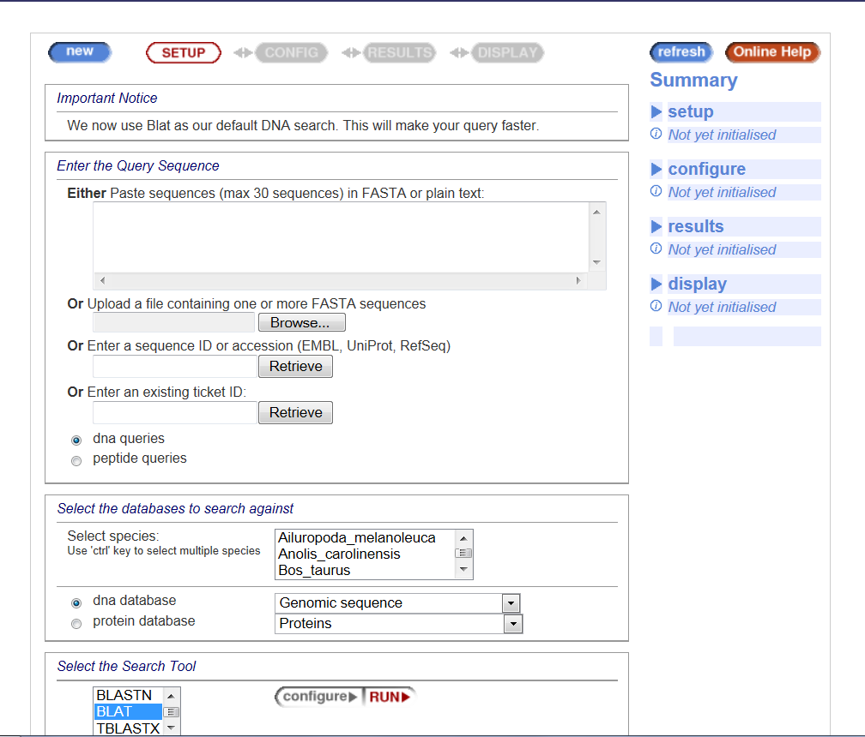
Direct Linkouts to Other Sites
Linkout to BLAST your sequence

Slide 21
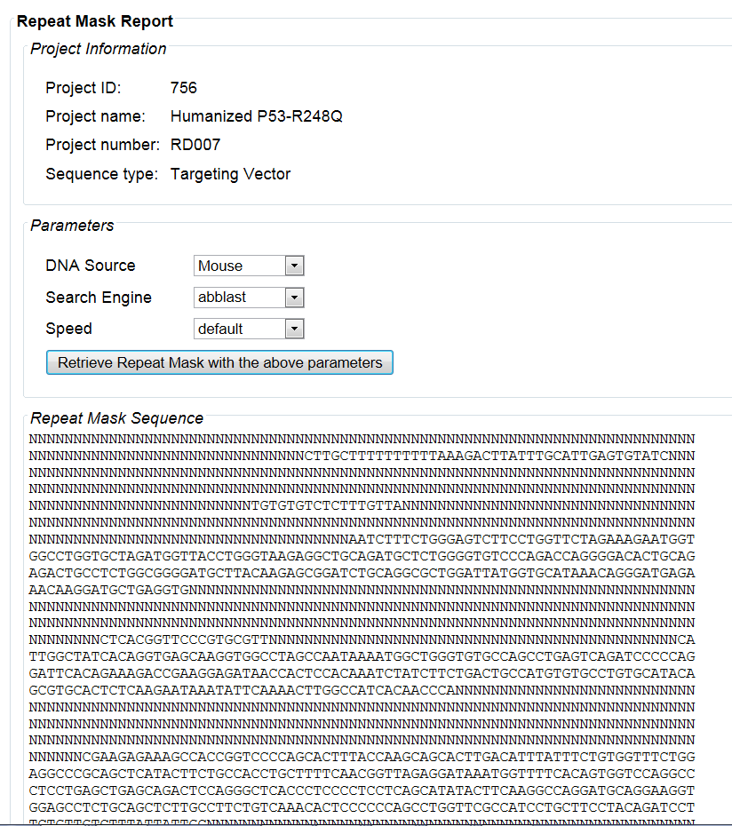
Direct Linkouts to Other Sites
Linkout to Repeat Masker for your sequence

Slide 22
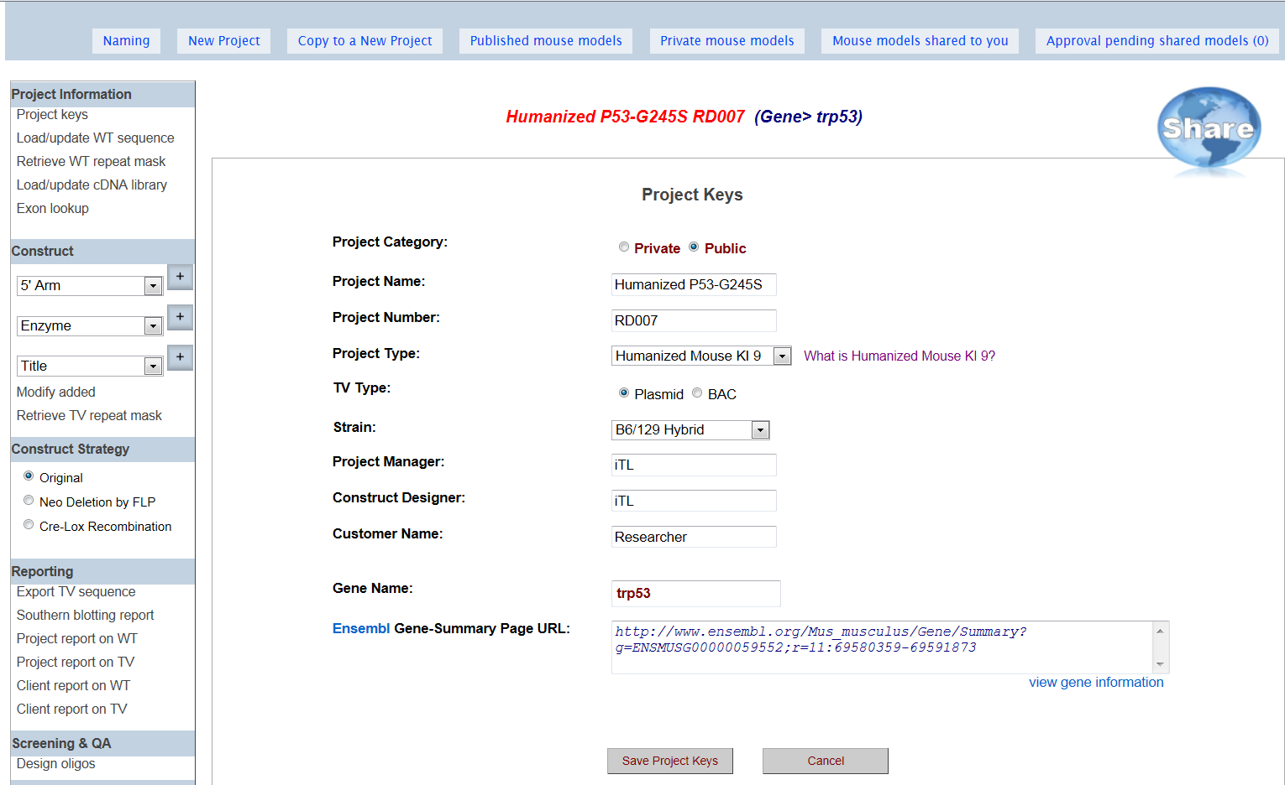
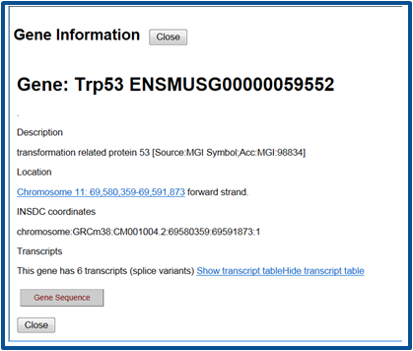
Project Information
Provide project keys
and gene info

Slide 23
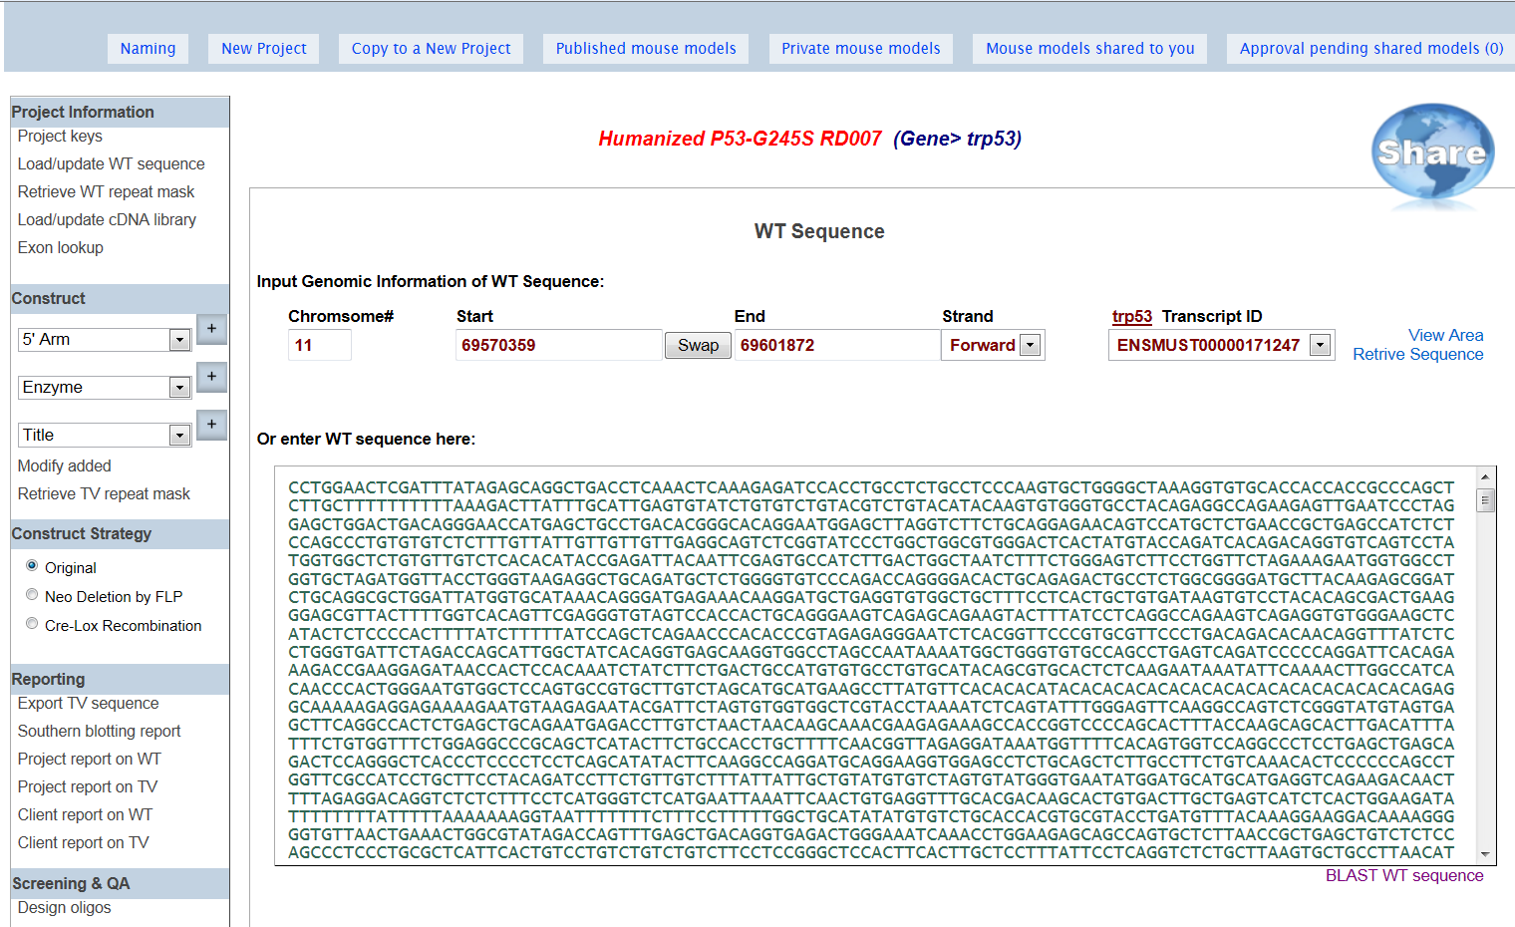
Project Information
Provide gene details

Slide 24
Results & Blog

Slide 25
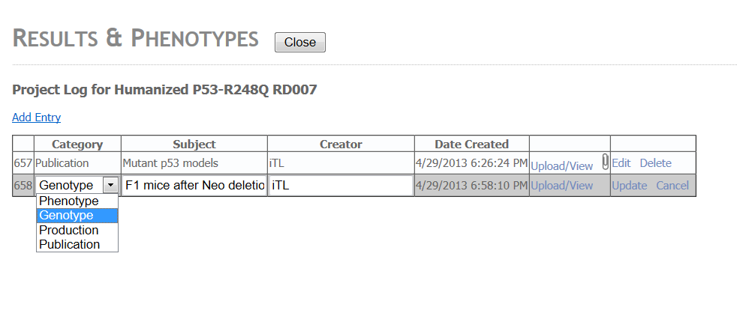
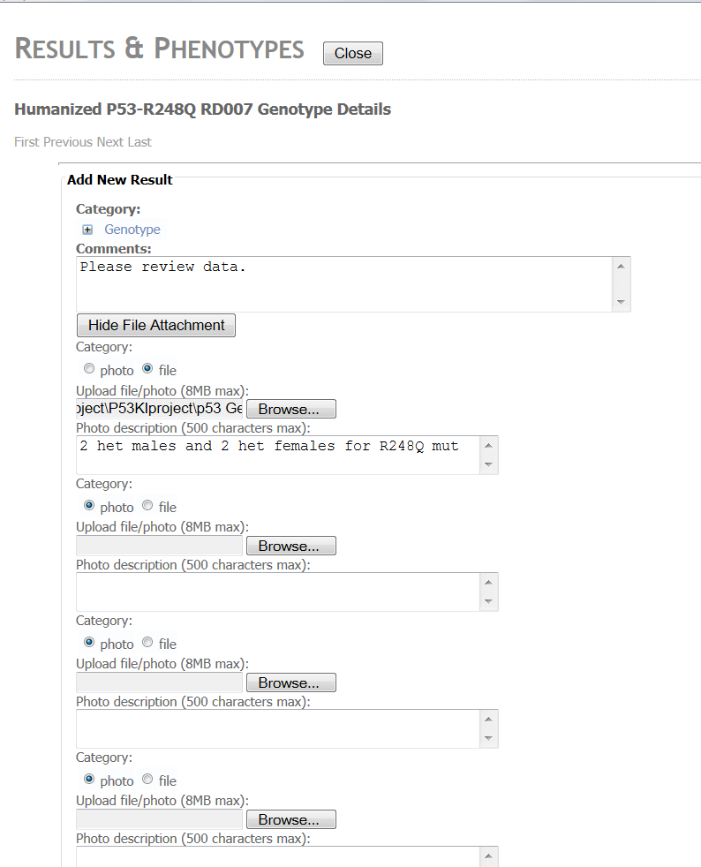
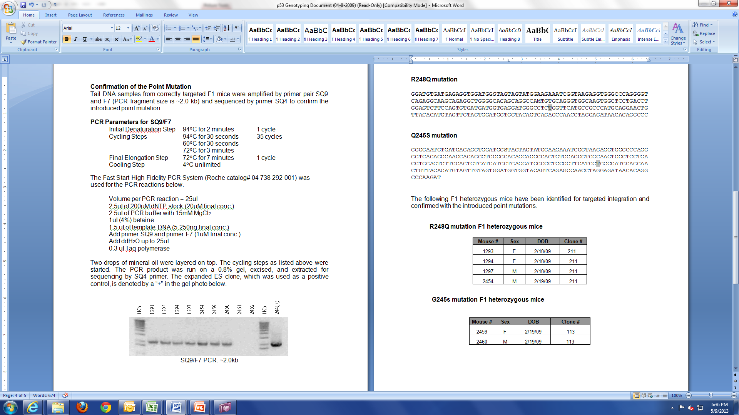
Results & Phenotypes
Add your updates, data, photos, publications, etc.

Slide 26
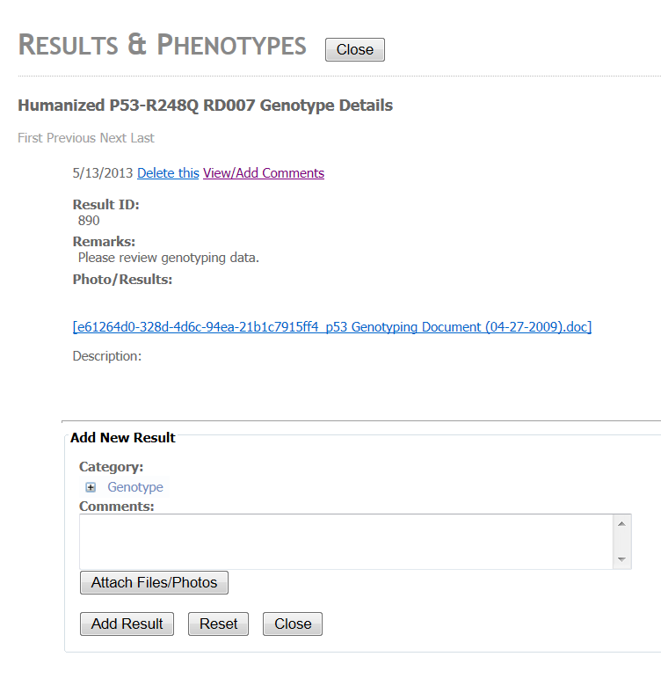
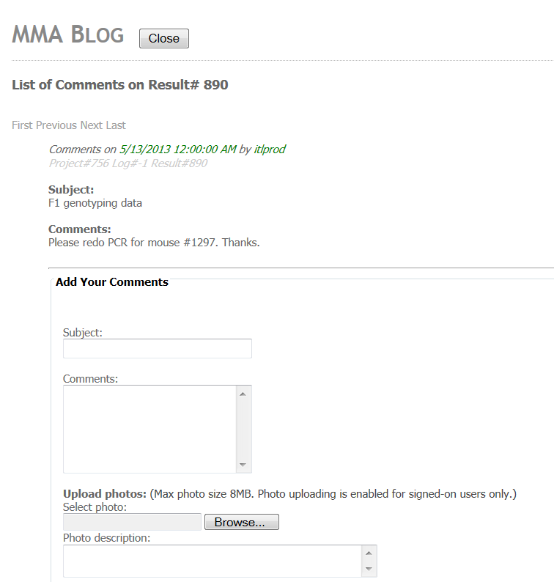
Results & Phenotypes
Add comments and feedback on uploaded data

Slide 27
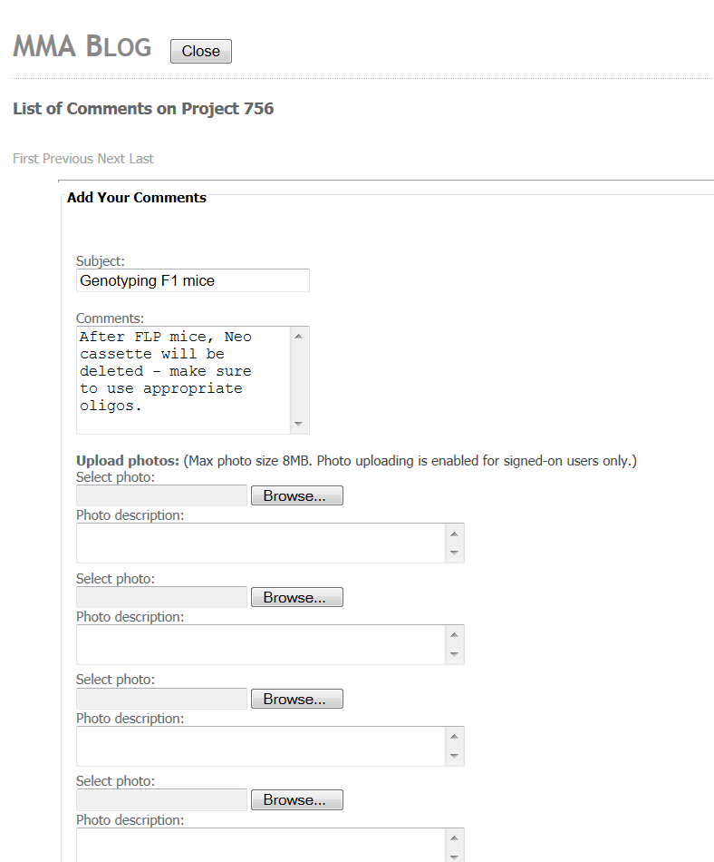
Blog
Communicate to lab members through project blog.

Slide 28
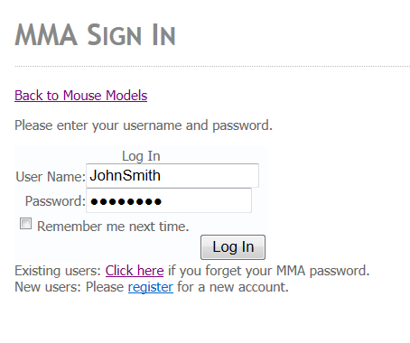
Personalized Login Account
Register for username and password
Once logged in, you have options to create your own new project, share your project with a collaborator, or publish your project.

Slide 29
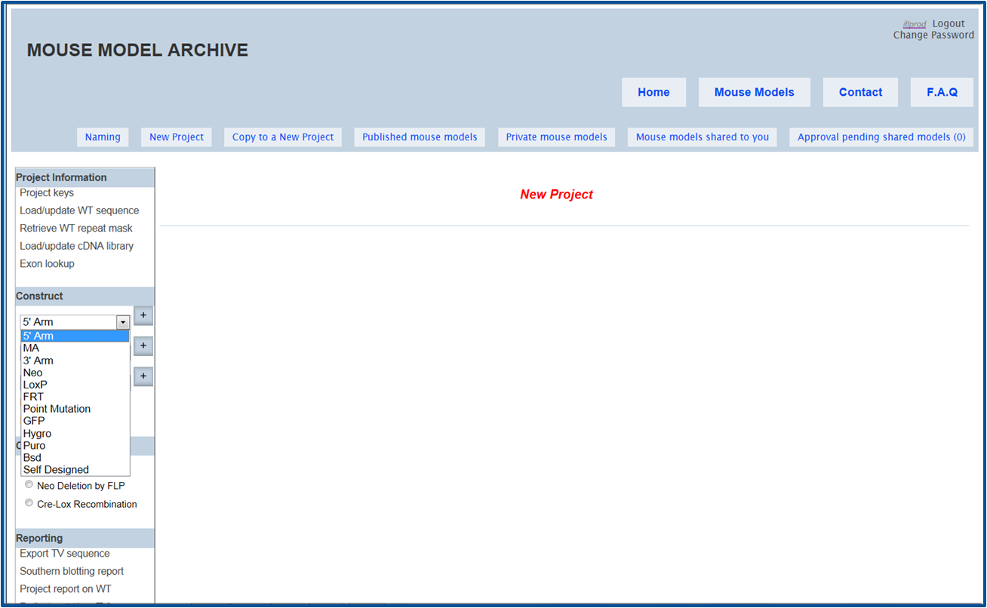
Create your own new project
Start your project design by entering your gene name and link to Ensembl.

Slide 30
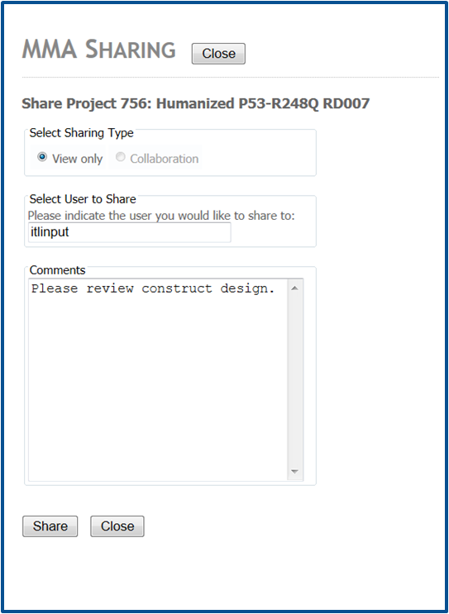
Share your project with your collaborator
Project can be shared as View Only or Collaborator

Slide 31
Projects that are shared to you
Options of View Only or Collaborator are indicated by the icon.

Slide 32
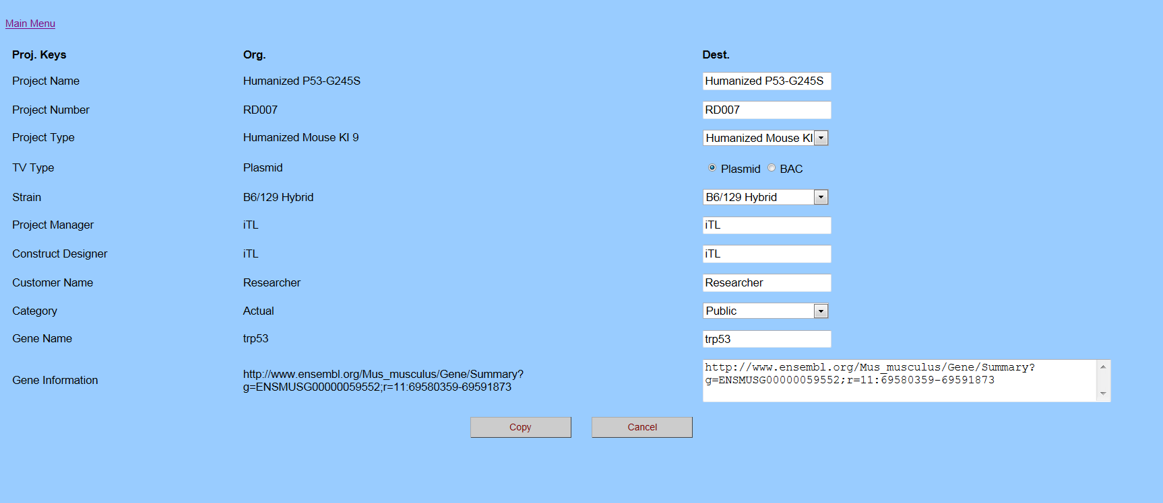
Copy shared project to your private model list
Use original copy as a reference while you can make and save any changes as you like.

Slide 33
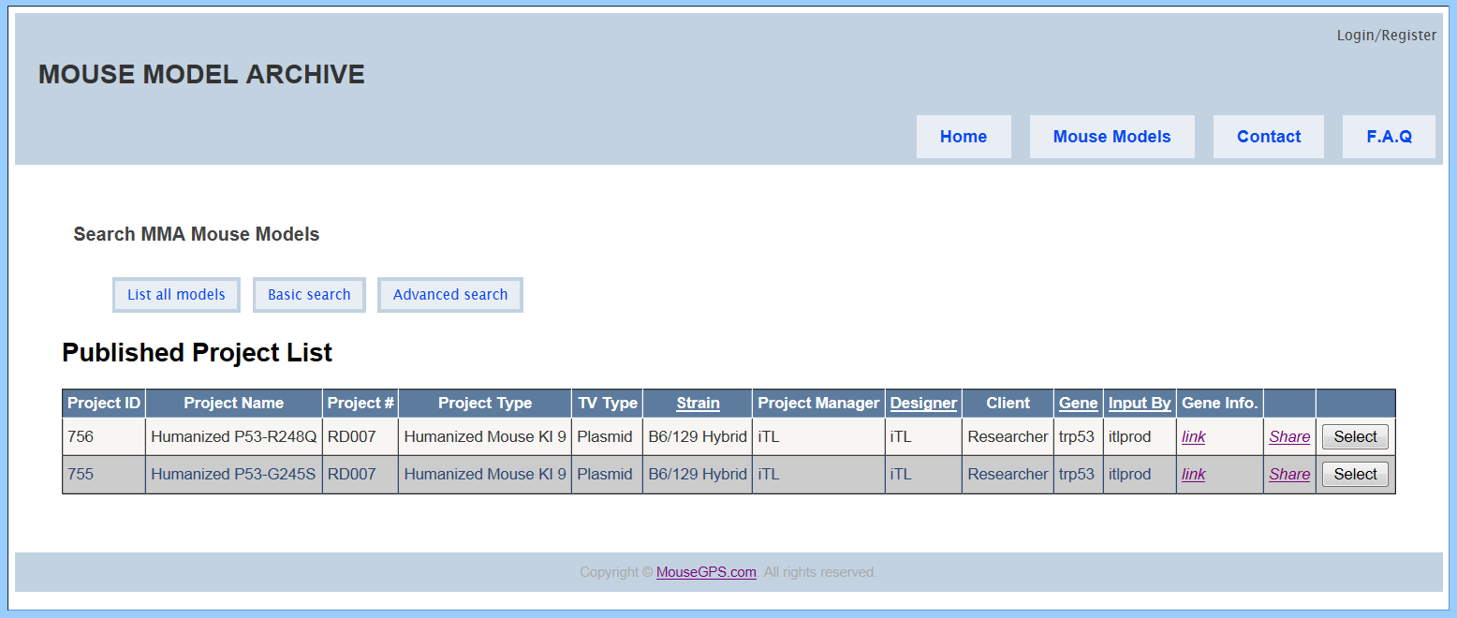
Change your project from private to public for all to view
Provide detailed and supplemental info for your published paper on your model.

Slide 34
Thank you for viewing.
If you have any questions or comments, please contact info@mousegps.com

